Slide 1
Word2Vec
with code
Sungjoon Choi

Slide 2
What we have is
['anarchism', 'originated', 'as', 'a', 'term', 'of', 'abuse', 'first', 'used', 'against', 'early', 'working', 'class', 'radicals', 'including', 'the', 'diggers', 'of', 'the', 'english', 'revolution', 'and', 'the', 'sans', 'culottes', 'of', 'the', 'french', 'revolution', 'whilst', 'the', 'term', 'is', 'still', 'used', 'in', 'a', 'pejorative', 'way', 'to', 'describe', 'any', 'act', 'that', 'used', 'violent', 'means', 'to', 'destroy', 'the', 'organization', 'of', 'society', 'it', 'has', 'also', 'been', 'taken', 'up', 'as', 'a', 'positive', 'label', 'by', 'self', 'defined', 'anarchists', 'the', 'word', 'anarchism', 'is', 'derived', 'from', 'the', 'greek', 'without', 'archons', 'ruler', 'chief', 'king', 'anarchism', 'as', 'a', 'political', 'philosophy', 'is', 'the', 'belief', 'that', 'rulers', 'are', 'unnecessary', 'and', 'should', 'be', 'abolished', 'although', 'there', 'are', 'differing', 'interpretations', 'of', 'what', 'this', 'means', 'anarchism', 'also', 'refers', 'to', 'related', 'social', 'movements', 'that', 'advocate', 'the', 'elimination', 'of', 'authoritarian', 'institutions', 'particularly', 'the', 'state', 'the', 'word', 'anarchy', 'as', 'most', 'anarchists', 'use', 'it', 'does', 'not', 'imply', 'chaos', 'nihilism', 'or', 'anomie', 'but', 'rather', 'a', 'harmonious', 'anti', 'authoritarian', 'society', 'in', 'place', 'of', 'what', 'are', 'regarded', 'as', 'authoritarian', 'political', 'structures', 'and', 'coercive', 'economic', 'institutions', 'anarchists', 'advocate', 'social', 'relations', 'based', 'upon', 'voluntary', 'association', 'of', 'autonomous', 'individuals', 'mutual', 'aid', 'and', 'self', 'governance', 'while', 'anarchism', 'is', 'most', 'easily', 'defined', 'by', 'what', 'it', 'is', 'against', 'anarchists', 'also', 'offer', 'positive', 'visions', 'of', 'what', 'they', 'believe', 'to', 'be', 'a', 'truly', 'free', 'society']
There is no ‘output’ nor ‘target’ in this problem.

Slide 3
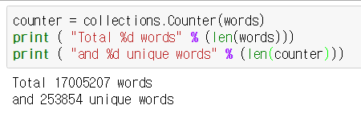
Too many words!
We will represent a word as an one-hot codded vector.
In this setting, each unique word will have 253,854 dimensional vector!

Slide 4
So, we will use more frequent words
Up to vocabulary_size (=50,000)
In other words, each word will be represented as a 50,000 dimensional one-hot codded vector.
What about other words?
Replace them with special token (UNK)

Slide 5
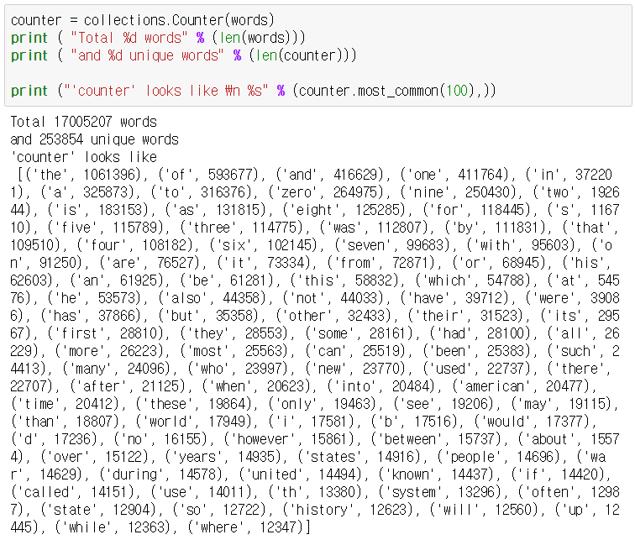
Implementation: counter

Slide 6
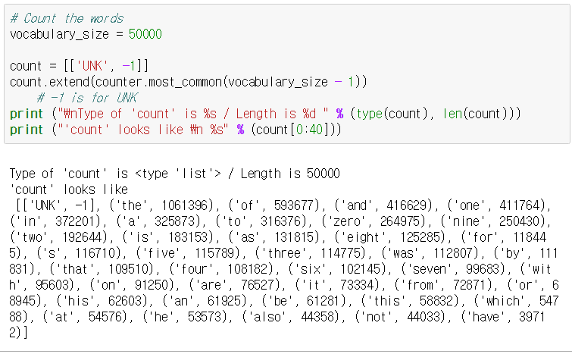
Implementation: counter

Slide 7
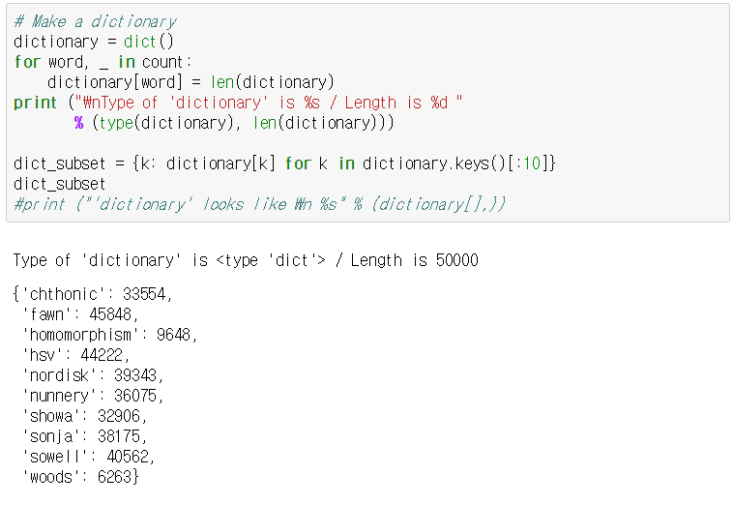
Implementation: dictionary

Slide 8
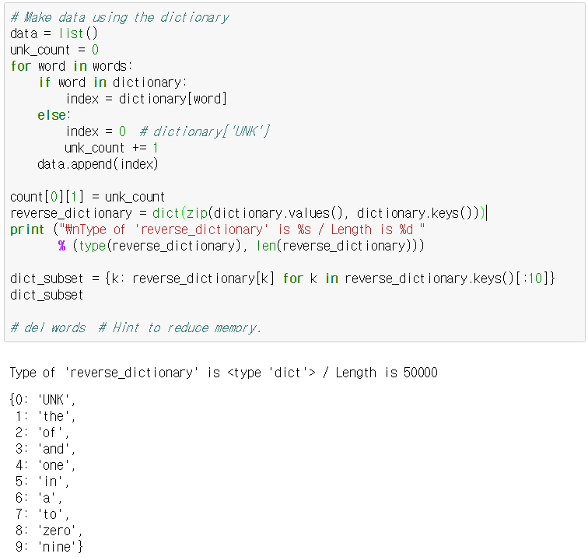
Implementation: reverse dict.

Slide 9
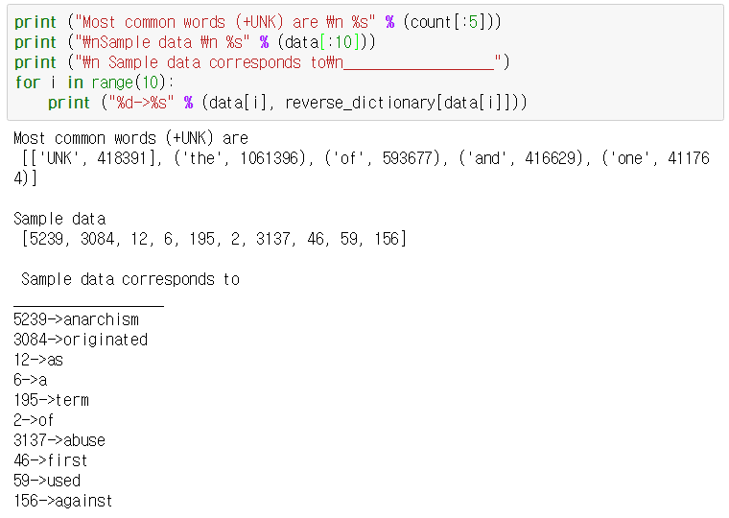
Implementation

Slide 10
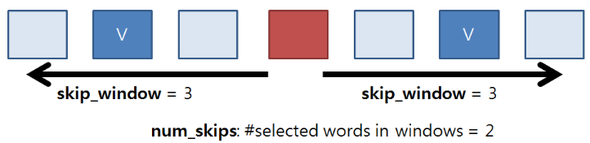
Skip-gram model

Slide 11
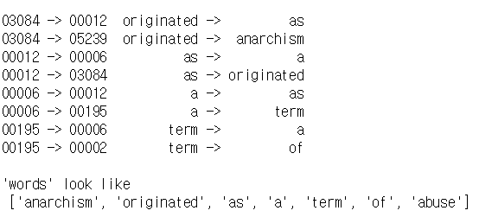
Skip-gram model

Slide 12
Implementation: Skip-gram
NeuralNet
next character[vocab_size]
rnn_output[rnn_size]
RNN@t-1
RNN@t
Embedding
rnn_input[rnn_size]
character[vocab_size]

Slide 13
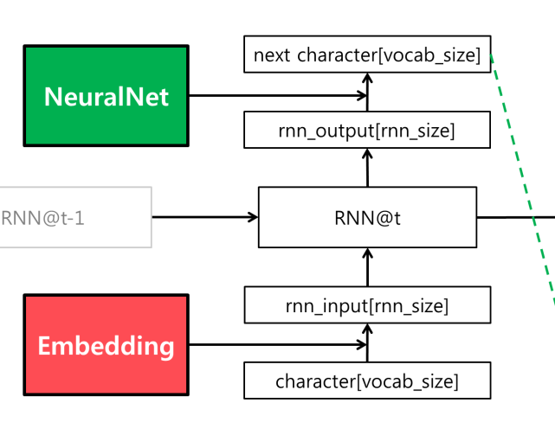
Implementation: Skip-gram
It has same structure as the char-rnn model.
But different objective → different cost function

Slide 14
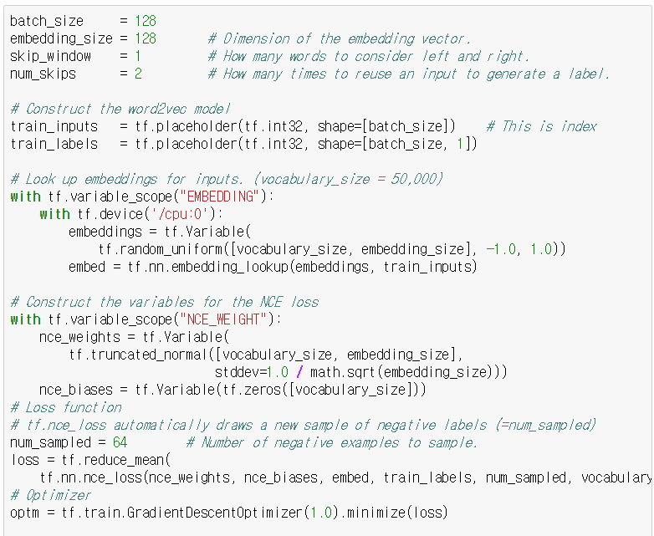
Implementation: Skip-gram

Slide 15
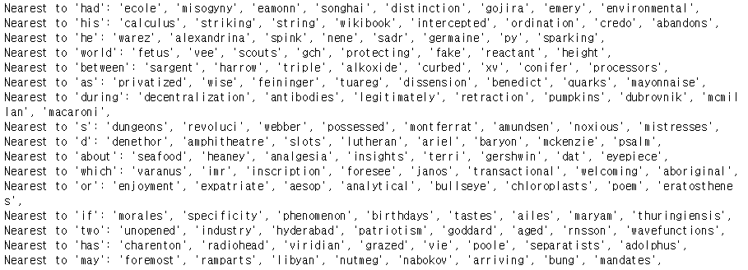
Results (iter: 0)

Slide 16
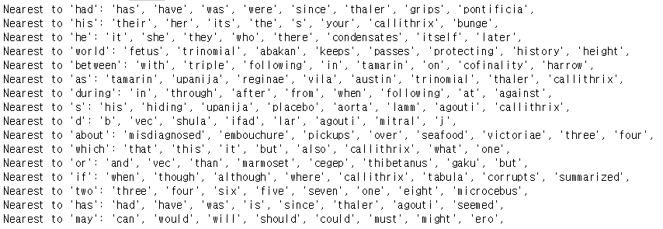
Results (iter: 100000)

